Slide 1
Introduction to Arduino
CSE 316
Peripherals & Interfacing Lab
Md. Mahedi Hassan
Lecturer, CSE, UAP

Slide 2
What is Arduino
Arduino board is an open-source platform used to make electronics projects.
It consists of both a microcontroller and a part of the software or Integrated Development Environment (IDE) that runs on your PC.
It is used to write & upload computer code to the physical board.
The platform of an Arduino has become very famous with designers or students just starting out with electronics, and for an excellent cause.

Slide 3
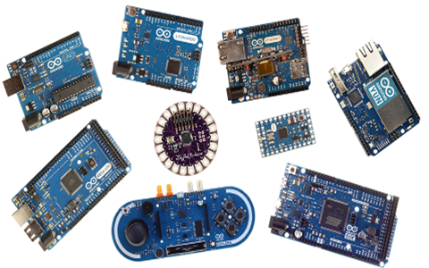
Different types of Arduino Boards
Fig 1. Different types of Arduino Boards.

Slide 4
Basic Features:
The Arduino does not require a separate part of hardware.
In order to program a new code onto the board you can just use a USB cable.
The Arduino IDE uses a basic version of C++, making it simpler to learn the program.
At last, Arduino board offers a typical form factor that breaks out the functions of the microcontroller into a more available package.

Slide 5
Why Arduino:
Arduino board has been used for making different engineering projects and different applications.
The Arduino software is very simple to use for beginners, yet flexible adequate for advanced users.
It runs on windows, Linux and Mac.
Teachers and students in the schools utilize it to design low cost scientific instruments to verify the principles of physics and chemistry.
Arduino also makes simpler the working process of microcontroller.

Slide 6
In a Nutshell:
Inexpensive
Cross-platform
Simple, clear programming environment
Open source and extensible software
Open source and extensible hardware

Slide 7
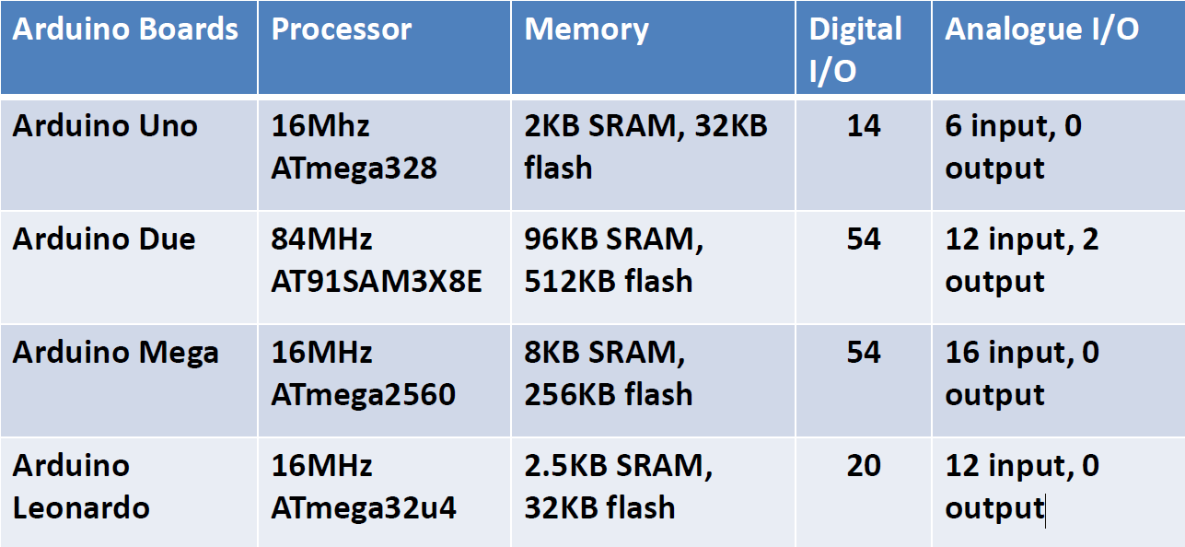
Feature analogy of different boards:

Slide 8
List of Arduino boards
Arduino Uno (R3)
LilyPad Arduino
Red Board
Arduino Mega (R3)
Arduino Leonardo

Slide 9
Arduino Uno R3
The Uno is a huge option for your initial Arduino.
It consists of 14-digital I/O pins, where 6-pins can be used as PWM(pulse width modulation outputs).
6-analog inputs, a reset button, a power jack, a USB connection and more.
It includes everything required to hold up the microcontroller.
Simply attach it to a PC with the help of a USB cable and give the supply to get started with a AC-to-DC adapter or battery.

Slide 10
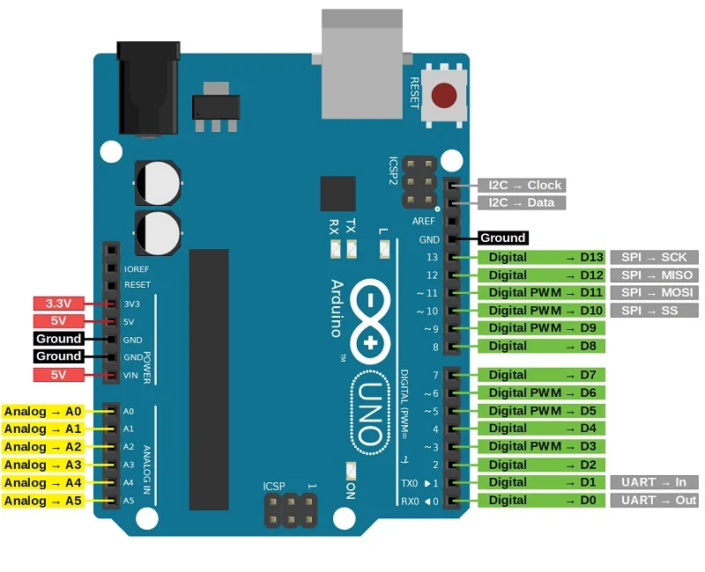
Arduino Uno (R3)

Slide 11
Some projects based on Arduino UNO:
Automatic Medicine Reminder Using Arduino
Obstacle Avoiding Robot using Arduino and Ultrasonic Sensor
Google Assistant Based Voice Controlled Home Automation using DIY Arduino Wi-Fi Shield
Self balancing robot
Line follower

Slide 12
Thank you

